Slide 1


ACCOUNTNG DOCUMENT OPEN AND CLEARED ITEMS
Submitted by:
Sangeetha Pulgam
Hari Krishna Saripalli
Shiva Prasad Sankabuddi
Under the Guidance of:
Upender Reddy Nallori

Slide 2
CONTENTS:
INTRODUCTION
IMPLEMENTATION
RESULTS
CONCLUSION
REFERENCE

Slide 3
INTRODUCTION:
Accounting Document Open and Cleared items is used to know the transaction status.
Open items: These are transactions that have been recorded but have not yet been fully settled or reconciled.
Cleared items: These are transactions that have been reconciled or settled.

Slide 4
IMPLEMENTATION:
Joining Tables Using for all Entries
Editable ALV Grid Display
Selection Blocks
User Commands
ALV Grid to PDF Generation
Edited data saving to Database
Adobe form Generating

Slide 5
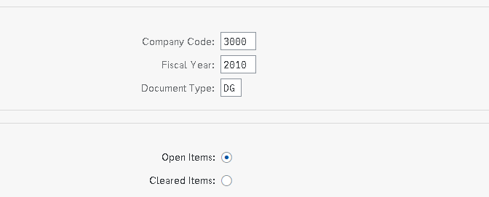
RESULTS:

Slide 6
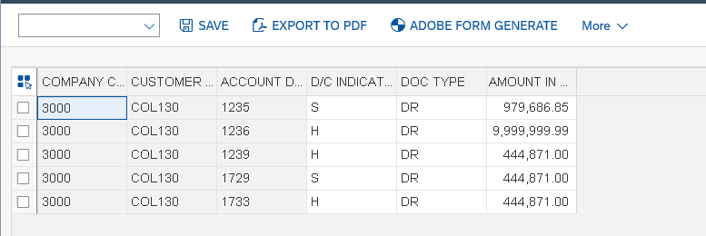
RESULTS:

Slide 7
CONCLUSION:
Accounting Document open and cleared items was successful and we got the expected output.

Slide 8
REFERENCE:
GitHub :

